Slide 1
Statistical & Machine Learning Group Project
Group 10
Marijose Marcos I.
Kamalakannan Thayanidhi
Swasthik Vellingirikowsalya

Slide 2



Team Members
Swasthik Vellingiri Kowsalya
Kamalakannan
Thayanidhi
Marijose
Marcos

Slide 3
Problem Definition/ Action
Problem:
The default rate on credit loans across banks has been at an all-time high.
The increase of default rate is causing financial/lending institutions to lose money.
Therefore:
Banks should know which clients are highly likely to default on next month’s loan payment based on certain characteristics and behavior.
This can be achieved through the implementation of a robust prediction model using Machine Learning Algorithms.
Notes:
Therefore, banks must have a risk prediction model and be able to classify the most relative characteristics that are indicative of people who have a higher probability of default on credit looking at features such as education, sex, civil situation and checking their importance.

Slide 4
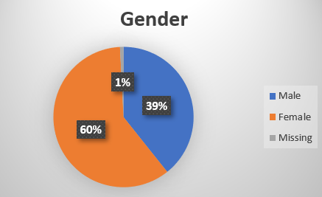
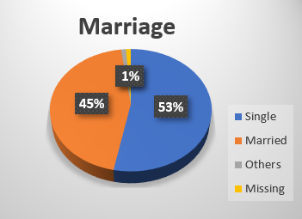
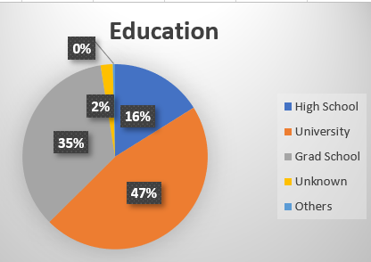
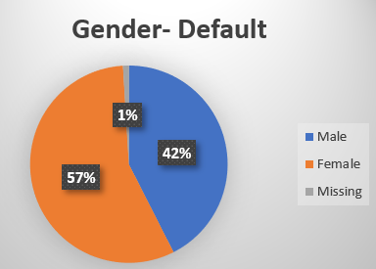
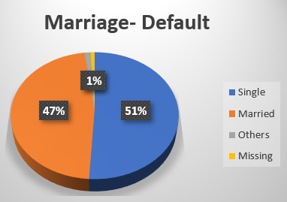
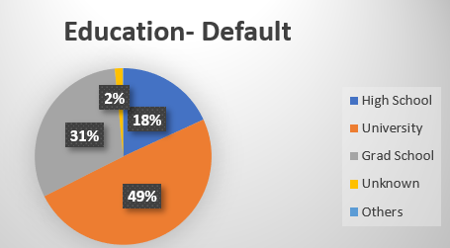
Data Exploration
Defaulters
Av Limit Balance: $166,700
Av Age: 35
Notes:
There is no remarkable difference in these variables, which means other features are major factors for defaulting, gender, marriage and education are not relevant features for default prediction.

Slide 5
Data Pre-Processing
Renaming categorical variables for category reduction
Drop variables with high missing percentage >30%
Filling NA’s
Encode categorical variables as int. for model prediction
Discretization of numeric variables for creation of bins
Data normalization
Dropping duplicates

Slide 6
Feature Engineering
Pearson Coefficient was used to identify few important variables in order to build new variables based on them.
The new variables created were,
Total Payment Per Customer
Total Bill Per Customer
Maximum and, Minimum of Pay & Bill
Average Payment Per Customer
Average Bill Amount Per Customer
Average Month Delay in Payment by customer
Maximum and Minimum Month Delay in Payment by customer
Maximum Bill value based on limit balance
Average Bill value based on limit balance
Average Payment in %

Slide 7
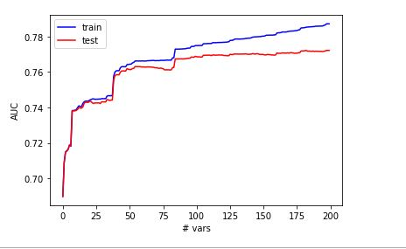
Feature Selection
Fisher’s score is used as a measure to select the important variables.
Here we can see that after Top 100 variables there is very little improvement in the AUC Score of the Test Data.

Slide 8
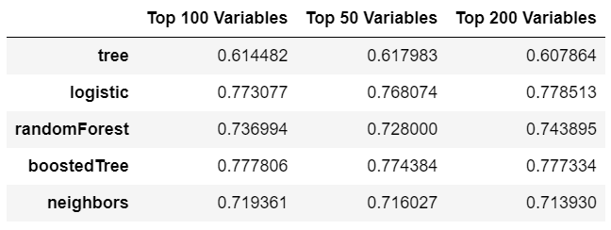
Feature Selection
5 different models were run for the top 200,100 and 50 variables individually and it is found that the top 100 variables had higher average AUC.

Slide 9
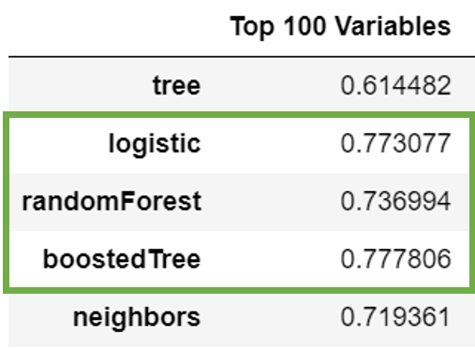
Model Selection
Top 3 performing models using the top 100 variables are selected for further steps.
The Models are:
Logistic Regression
Random Forests
Gradient Boosting

Slide 10
Modeling & Experimental Setup
Nested Cross validation is used to optimize the hyperparameters of the models and to evaluate and compare tuned machine learning models.
The outer cross validation is 5 fold and the inner one is 3 fold.
The parameter values used in Grid Search for Gradient Boosting are,
n_estimators = 50,100,500,1000
max_depth = 5,7,10,12,15
learning_rate = 0.001,0.01,0.1
The parameter values used for Random Forests are,
n_estimators = 10,100,500
max_features = 2,4,6

Slide 11
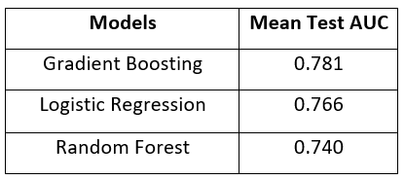
Experimental Setup Results
Based on the results, the gradient boosting has the highest mean test AUC and hence selected as the best model model for final prediction.
Final parameters selected for Gradient Boosting are:
Learning_rate = 0.01
max_depth = 5
Number_of_estimators = 500

Slide 12
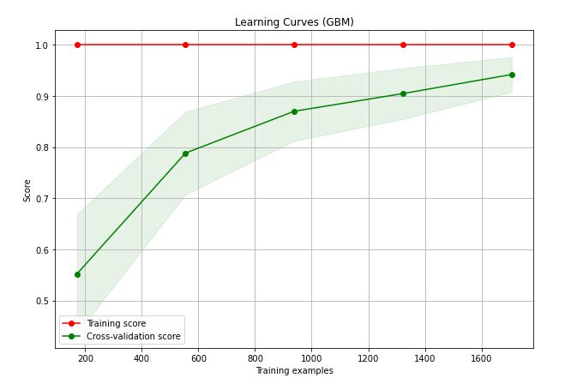
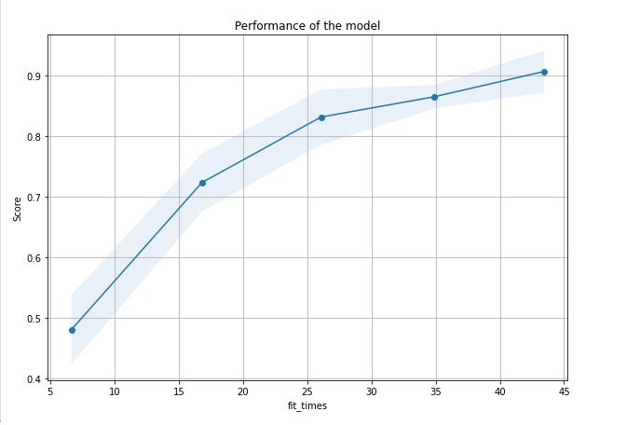
Results
We can clearly see that the training score is maximum and the Cross - Validation Score could be improved by giving more samples to train for the model.
The Graph on the right shows us how much time was required to train the models for each training size.

Slide 13
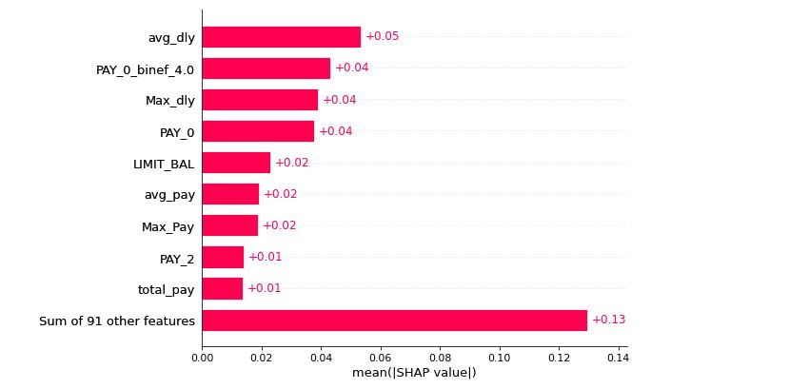
Feature Importance
The Features are ordered by how much they influenced the model’s prediction.
The Top 5 Features are -
Average Months Delay in Payment
Payment Delay of 4 months
Maximum Months of Delay in Payment
Payment Status in September
Limit Balance of Customer

Slide 14
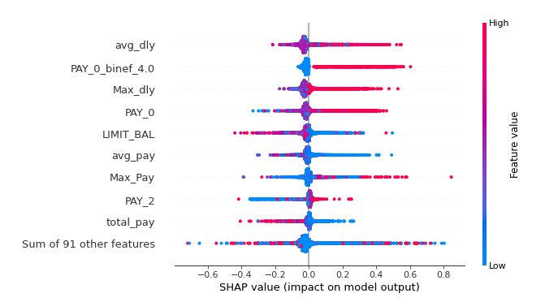
Interpretation
The Higher the Average Delay of Payment the higher the probability of default of Credit Card.
When the Payment delay is at 4 months there is higher probability of Default in the coming month.
The Higher the Maximum Delay of Payment the higher the probability of default.
When the Payment Months delay is higher there is probability of Default in the coming month.
The Higher the Limit Balance the lesser is the probability of Default

Slide 15

Q & A

